Slide 1
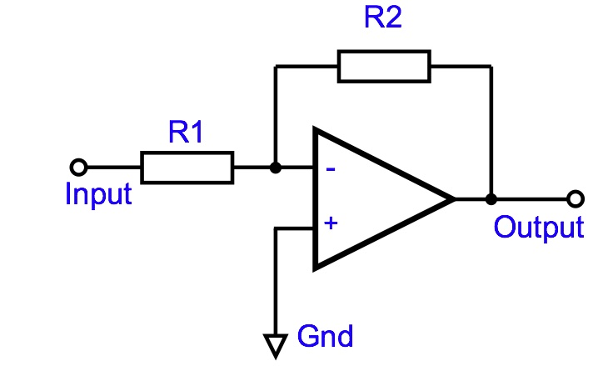
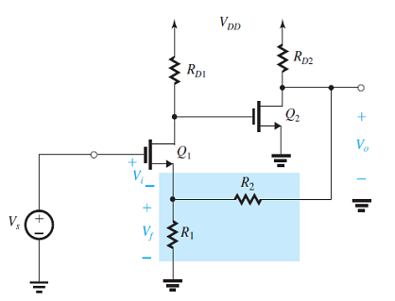
Quiz 5
Deadline: May 15, 2020
1. An ideal op-amp is used as an inverting amplifier as shown in the Figure. Note that v_{i} has polarity the same as input terminals of op-amp. Use theory of feedback to find
β
A_{f}
If A = 10000, R₂ = 20k, R₁ = 1k and A decreases by 20% what is the corresponding increase in A_{f}?
v_{S}
v_{o}
v_{i}
A
2. The feedback circuit is shown in the Figure
What is the feedback topology?
Chose R₁ and R₂ to obtain the voltage gain of A_{f} = 20, assuming that the open loop gain is very large.
Assume that DC component V_{D1} increases due to some reasons, explain how to automatically keep V_{D1} constant.

